Slide 1
Adventure Works
By ExcelR

Slide 2


Group 4
K Mahendra
Kishor Kumar
B Veeranjaneyulu
Kanika Sharma
E Jyothi

Slide 3

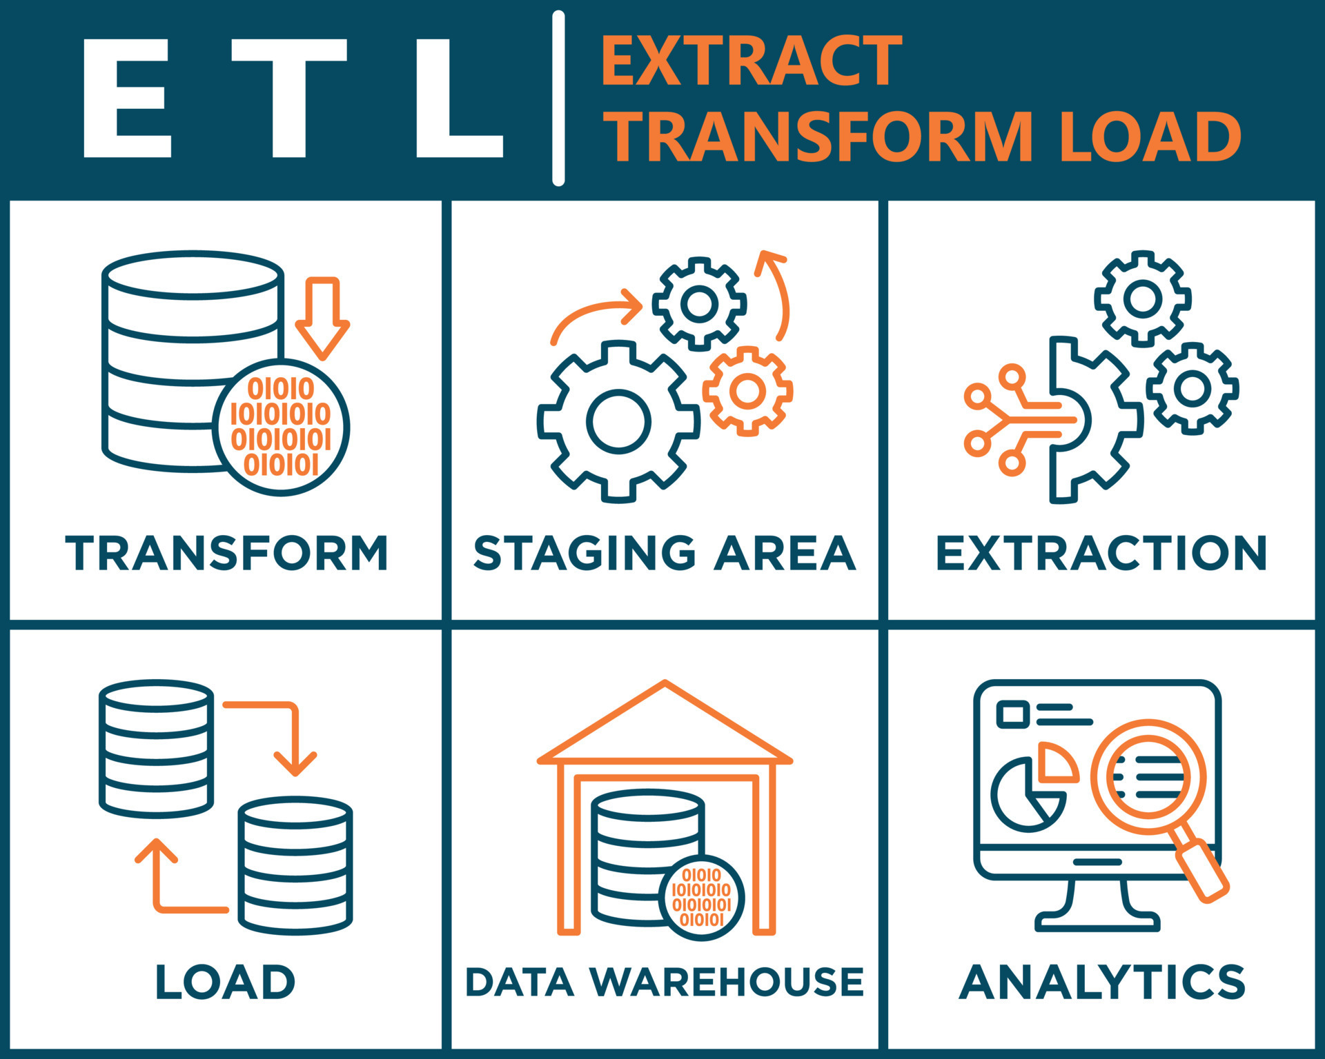


Project Overview
Analyzed sales data using Excel, SQL, Tableau, and Power BI.
Cleaned and transformed the data to ensure accuracy and consistency.
Created KPIs, charts, and interactive dashboards for data visualization.
Generated meaningful business insights to support data-driven decision-making.

Slide 4
Workflow Followed
1
Raw Data
2
Data Cleaning &SQL Processing
Data Analysis Process
3
Excel Analysis
4
Tableau &
power BI Dashboard
5
Business Insights

Slide 5



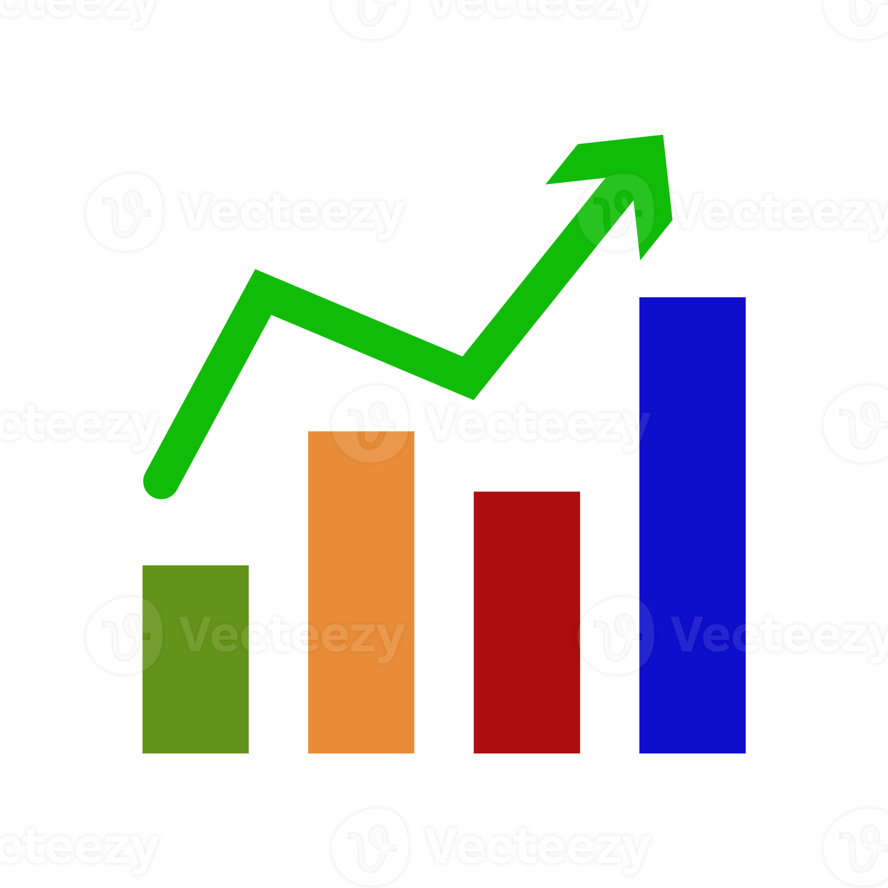


Project Objectives
Clean and organize sales data.
Calculate Sales Amount, Production Cost, and Profit.
Build interactive dashboards.
Analyze sales performance by Year, Product, Customer, and Re Region.
Support data-driven business decisions.

Slide 6
Key Takeaways
Learned SQL for data extraction and data manipulation.
Used Excel formulas, Pivot Tables, and charts for analysis.
Built interactive dashboards in Tableau.
Created Power BI dashboards using DAX and visualizations.
Improved data analysis and data storytelling skills.

Slide 7
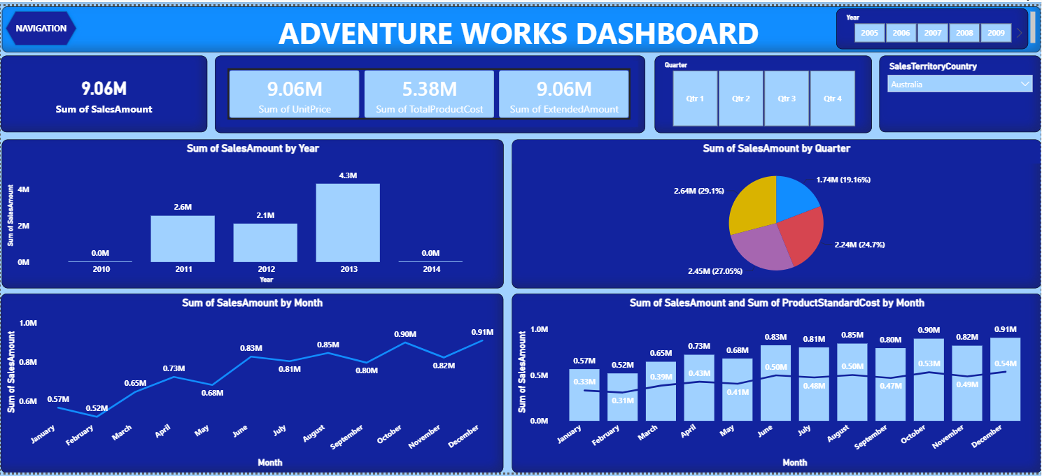
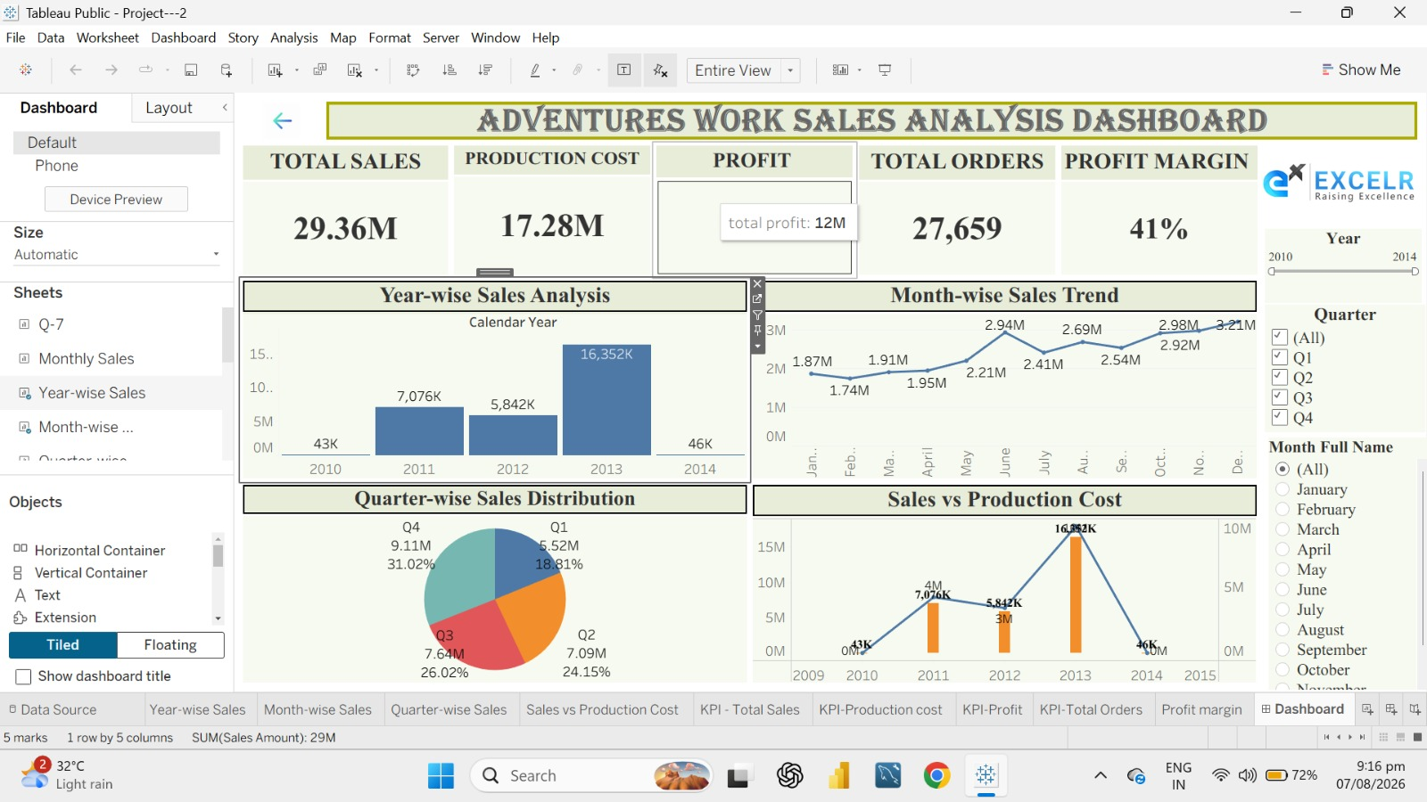
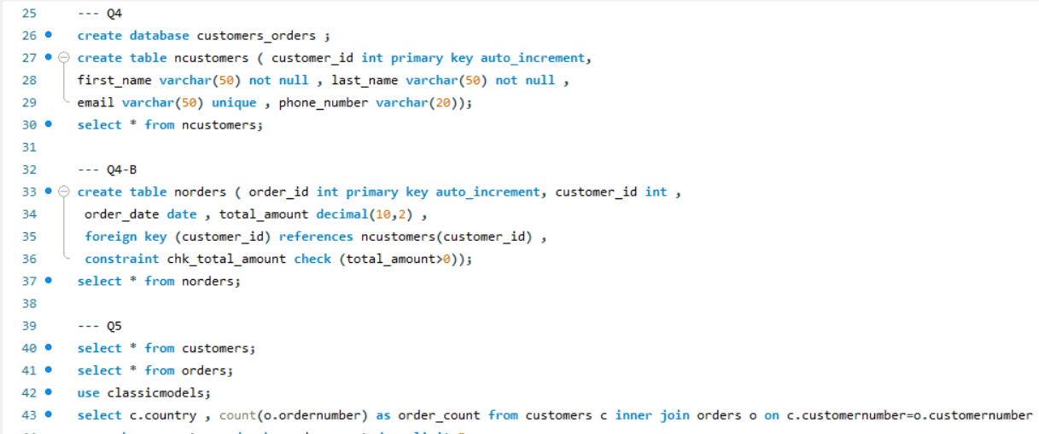
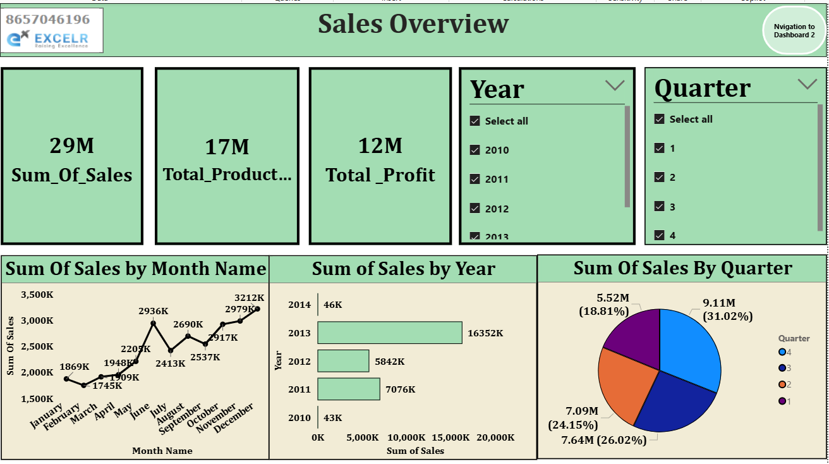
Combined Dashboards

Slide 8


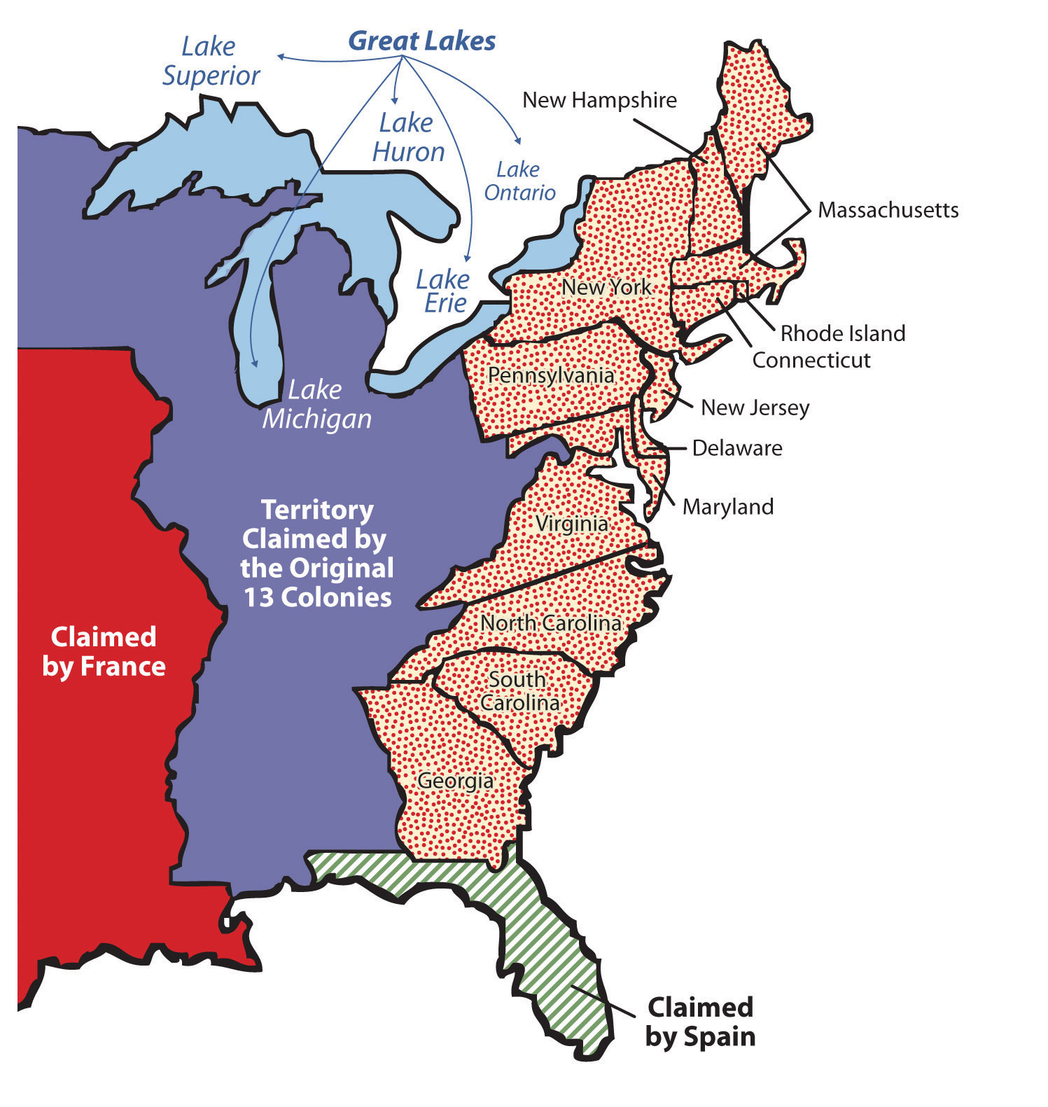



Key Insights & Interpretation
Sales increased over the years.
Some regions generated higher revenue.
A few products contributed the highest sales.
Profit margins varied across products.
Monthly sales showed seasonal trends.

Slide 9
Conclusion
Successfully Analysed sales data using Excel,SQL,Tableau,and Power BI.
1
Built In Interactive Dashboards for Effective Data Visualization.
2
I Identified Key Sales Trends and Business Insights to Support Decision Making.
3

Slide 10
Thank You

